Slide 1
BAN 502 – Module 4 Dealing with Missing Data
Dr. Avinash Geda

Slide 2
Missingness
Missingness → The absence of data
Types of Missingness:
Missing at random
Missing not at random
How to handle?
Treat missingness as data → “Missing” could be a category
Row-wise deletion
Column-wise deletion
Imputation

Slide 3
Missingness Example
Weight | Height | Athlete
150 | 68 | No
NA | NA | No
210 | 77 | Yes
195 | 73 | Yes
185 | 70 | NA
200 | NA | Yes
205 | 70 | No

Slide 4
Missingness Example
Weight | Height | Athlete
150 | 68 | No
NA | NA | No
210 | 77 | Yes
195 | 73 | Yes
185 | 70 | NA
200 | NA | Yes
205 | 70 | No

Slide 5
Missingness Example (Row-wise deletion)
Weight | Height | Athlete
150 | 68 | No
NA | NA | No
210 | 77 | Yes
195 | 73 | Yes
185 | 70 | NA
200 | NA | Yes
205 | 70 | No

Slide 6
Missingness Example (Column-wise deletion)
Weight | Height | Athlete
150 | 68 | No
NA | NA | No
210 | 77 | Yes
195 | 73 | Yes
185 | 70 | NA
200 | NA | Yes
205 | 70 | No

Slide 7
Missingness Example (Imputation) Mean
Weight | Height | Athlete
150 | 68 | No
191 | 72 | No
210 | 77 | Yes
195 | 73 | Yes
185 | 70 | ??
200 | 72 | Yes
205 | 70 | No

Slide 8
Imputation
Many possibilities
Common options:
Mean
Hot deck → Substitute from similar observation (randomly)
Cold deck → Hot deck without randomness
Regression

Slide 9
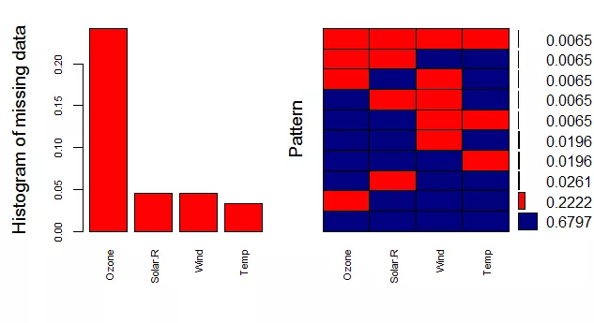
Dealing with Missing Data in Software

